Slide 1
Fonts
This presentation template uses Oracle Sans and Georgia.
Every employee at Oracle have these font families installed on their machines.
For presentations, please make sure your machine has Oracle Sans installed.
For sending externally, please save the PPT as a PDF so the fonts will properly display

Slide 2
Team: DERAAK
Lightning Talk
Derrick Cameron
Aakash Desai
Developer Innovations, NA Cloud Solution Engineering

Slide 3
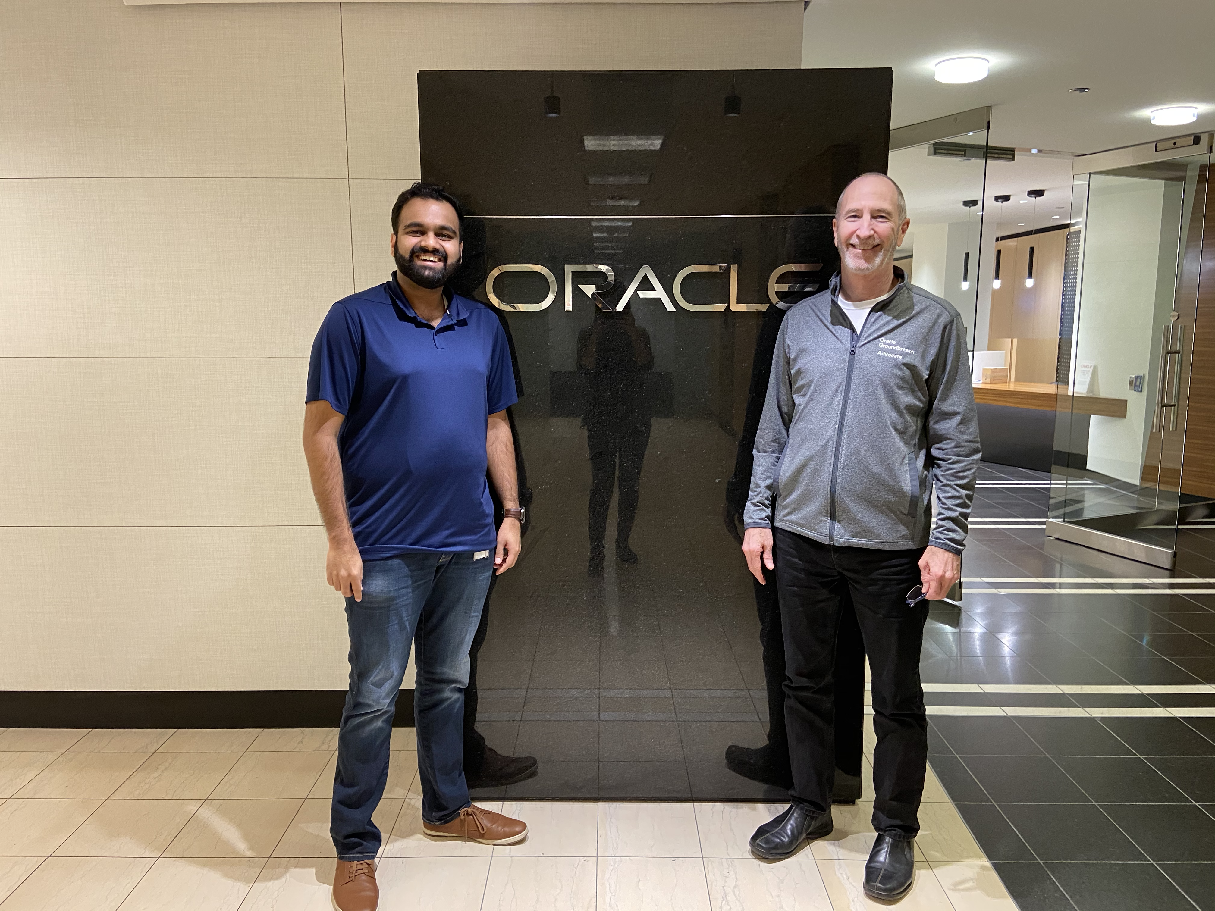
Goal:
Next Phase:
Develop a machine learning model to categorize Incoming Support Calls that are uncategorized or need to be re-categorized to optimize service call response.
.
Tune the various machine learning models for further accuracy.
Run a clustering algorithm to identify a natural distribution within the data.
Value:
An advanced classification system can dramatically improve customer satisfaction and customer support.
Oracle Analytics Cloud is a great starting point for citizen data scientists.
Oracle Text is the improves model learning for data containing unstructured text and documents.

Slide 4

Oracle Analytics Cloud
Customer
Identity
Cloud Service
Oracle Machine Learning
Autonomous Data Warehouse
Object Storage

Slide 5
Demonstration

Slide 6
Thank you

